Slide 1
Database Management Systems
By:
Dr. Neha Nandal
Computer Science and Engineering

Slide 2
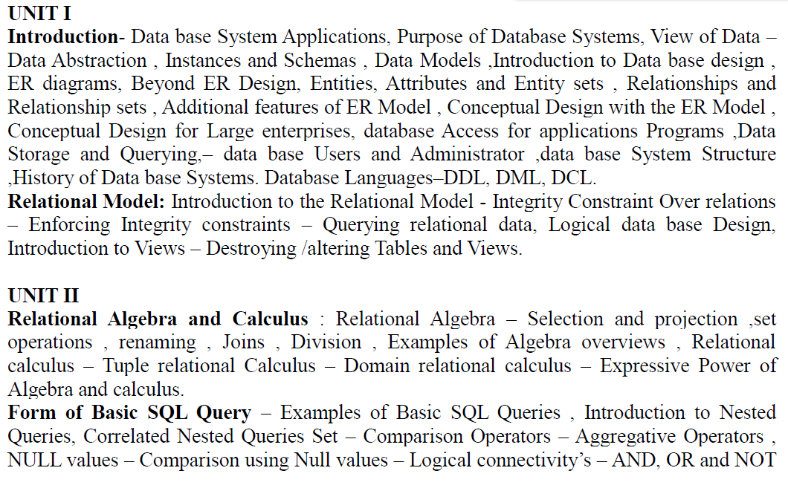
DATABASE MANAGEMENT SYSTEMS

Slide 3
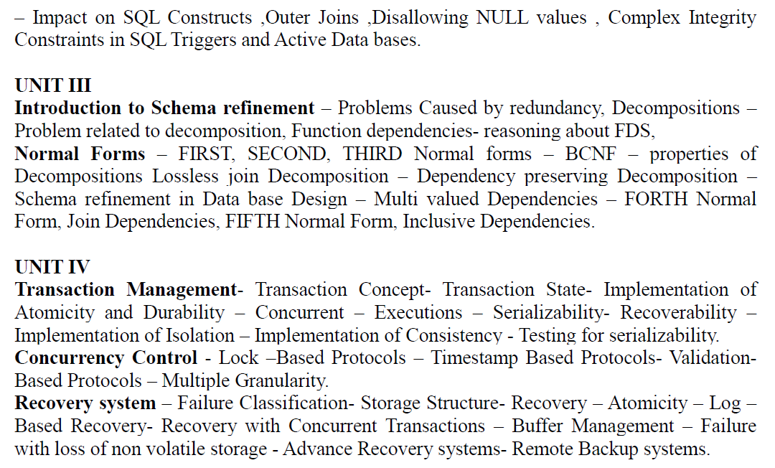
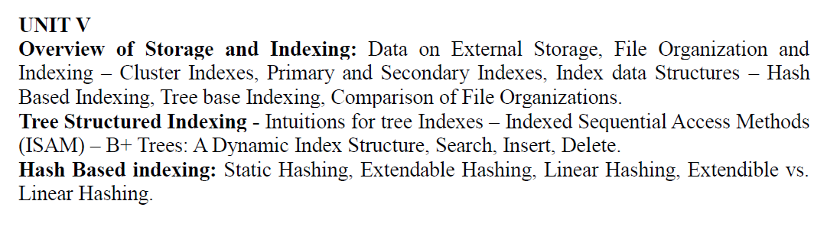

Slide 4
TEXT BOOKS:
1. Data base System Concepts, Silberschatz, Korth, McGraw hill, Sixth Edition.(All UNITS except III th)
2. Data base Management Systems, Raghurama Krishnan, Johannes Gehrke, TATA McGrawHill 3rd Edition.

Slide 5
Unit 1: introduction
What is Management System?
A database-management system (DBMS) is a collection of interrelated data and a set of programs to access those data.
This is a collection of related data with an implicit meaning and hence is a database. The collection of data, usually referred to as the database, contains information relevant to an enterprise.
The primary goal of a DBMS is to provide a way to store and retrieve database information that is both convenient and efficient.
By data, we mean known facts that can be recorded and that have implicit meaning.

Slide 6
Database Management System (DBMS) and Its Applications:
1. Banking
2. Airlines
3. Universities
4. Manufacturing and selling
5. Human resources

Slide 7
Purpose of Database Systems
This typical file-processing system is supported by a conventional operating system. Keeping organizational information in a file-processing system has a number of major disadvantages:
Data redundancy and inconsistency
Difficulty in accessing data
Data isolation.
Integrity problems
Atomicity problems
Concurrent-access anomalies
Security problems

Slide 8
Advantages of Database Systems
This typical file-processing system is supported by a conventional operating system. Keeping organizational information in a file-processing system has a number of major disadvantages:
Controlling of Redundancy
Improved Data Sharing
Data Integrity
Security
Data Consistency
Efficient data access
Enforcements of Standards
Data Independence

Slide 9
Disadvantages of DBMS
1) It is bit complex. Since it supports multiple functionality to give the user the best, the underlying software
has become complex. The designers and developers should have thorough knowledge about the software
to get the most out of it.
2) Because of its complexity and functionality, it uses large amount of memory. It also needs large memory to
run efficiently.
3) DBMS system works on the centralized system, i.e.; all the users from all over the world access this
database. Hence any failure of the DBMS, will impact all the users.
4) DBMS is generalized software, i.e.; it is written work on the entire systems rather specific one. Hence some
of the application will run slow.

Slide 10
Aspect | File Processing System | Database Management System (DBMS)
Data Organization | Data is stored in flat files (e.g., text, binary). | Data is organized in structured formats like tables (relational) or collections (NoSQL).
Data Redundancy | High potential for data redundancy and duplication. | Designed to minimize redundancy through normalization and constraints.
Data Access | Sequential access; searching and retrieval can be inefficient. | Efficient data retrieval using query languages (e.g., SQL) and indexing.
Data Integrity | Integrity must be managed manually; few built-in constraints. | Enforced through constraints, triggers, and rules to ensure consistency.
Concurrency Control | Limited or no built-in mechanisms for handling concurrent access. | Provides mechanisms for concurrent access (e.g., transactions, locking).
Scalability | Difficult to scale; performance may degrade with large data volumes. | Designed to handle large volumes of data and support scaling through various techniques.
Data Relationships | Relationships between data must be managed manually. | Supports complex relationships through foreign keys, joins, and referential integrity.
Backup and Recovery | Typically manual; less robust and automated. | Robust and automated backup and recovery options, including transaction logs and point-in-time recovery.
Data Management | Data management is often limited to basic operations. | Provides comprehensive data management capabilities, including advanced querying and reporting.
Data Security | Basic security mechanisms, often limited to file system permissions. | Advanced security features, including user roles, permissions, and encryption.

Slide 11
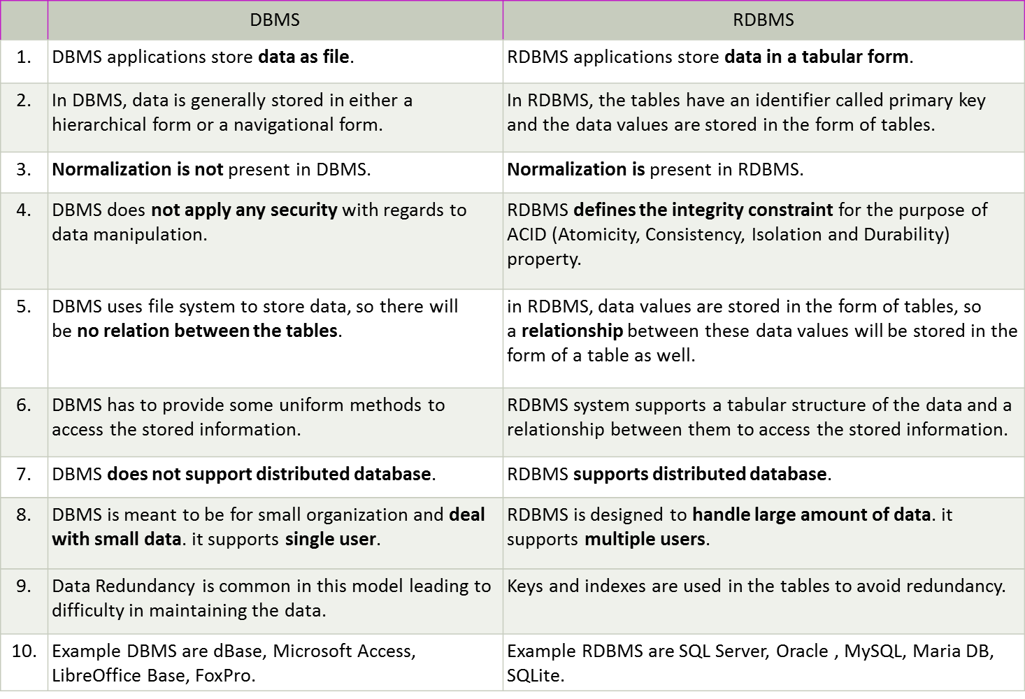

Slide 12
View of Data
A database system is a collection of interrelated data and a set of programs that allow users to access and modify these data. A major purpose of a database system is to provide users with an abstract view of the data. That is, the system hides certain details of how the data are stored and maintained.
Since many database-system users are not computer trained, developers hide the complexity from users through several levels of abstraction, to simplify users’ interactions with the system

Slide 13
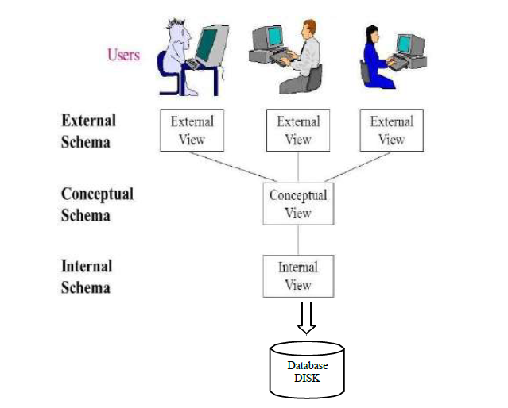

Slide 14
Instances and Schemas
Databases change over time as information is inserted and deleted. The collection of information stored in the
database at a particular moment is called an instance of the database. The overall design of the database is
called the database schema
Each variable has a particular value at a given instant. The values of the variables in a program at a point in
time correspond to an instance of a database schema. Database systems have several schemas, partitioned
according to the levels of abstraction..

Slide 15
Data Models
Underlying the structure of a database is the data model: a collection of conceptual tools for describing data, data relationships, data semantics, and consistency constraints.
Relational Model. The relational model uses a collection of tables to represent both data and the relationships among those data. Each table has multiple columns, and each column has a unique name. Tables are also known as relations.
Entity-Relationship Model. The entity-relationship (E-R) data model uses a collection of basic objects, called identities, and relationships among these objects.
Object-Based Data Model. object-oriented data model that can be seen as extending the E-R model with notions of encapsulation, methods (functions), and object identity.
Semi-structured Data Model. The semi-structured data model permits the specification of data where individual data items of the same type may have different sets of attributes.

Slide 16
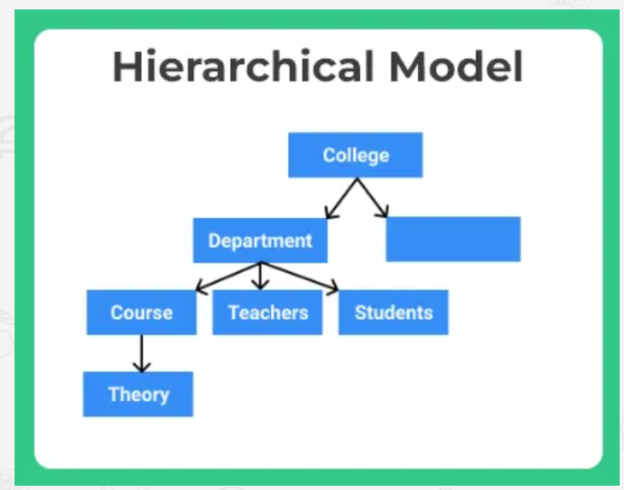
Hierarchical database model
The Hierarchical model is inspired from tree based data structure format. Where in there is a single root node and other data is linked to the same and expands like a tree.
A child node data may only have a single parent node
For any parent node one to many relationship must be maintained.

Slide 17
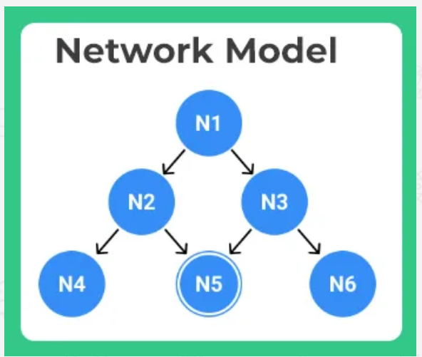
Network model
Network model was made to overcome the drawbacks for hierarchical model. This works more like a graph rather than a tree.
As the name suggests there is network based looped relationship between various data linked to one another.
A child node may have more than one parent. ( As for Node – N6)
There can be many to many relationships between data.

Slide 18
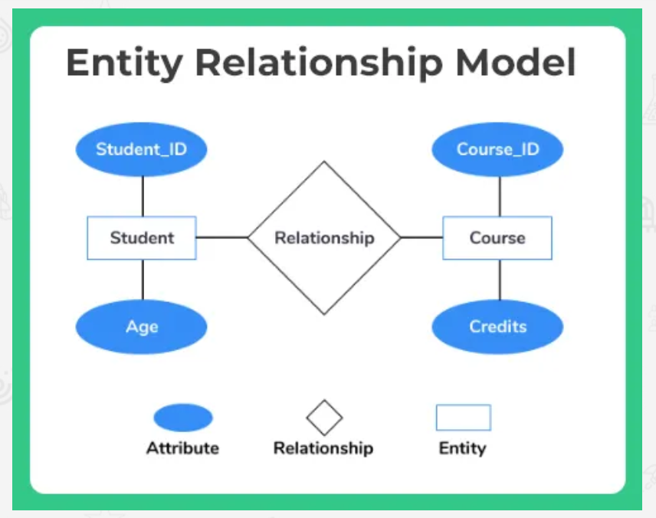
Entity-relationship model
This is modeled about break and related model, i.e. we break data into different components based on characteristics, in terms of entity and attributes.
Imagine an entity student, its various attributes maybe studentID, age, dateOfBirth etc etc. It may have a relationship with courses offered to the student, which further may have attributes like CourseID and credits.

Slide 19
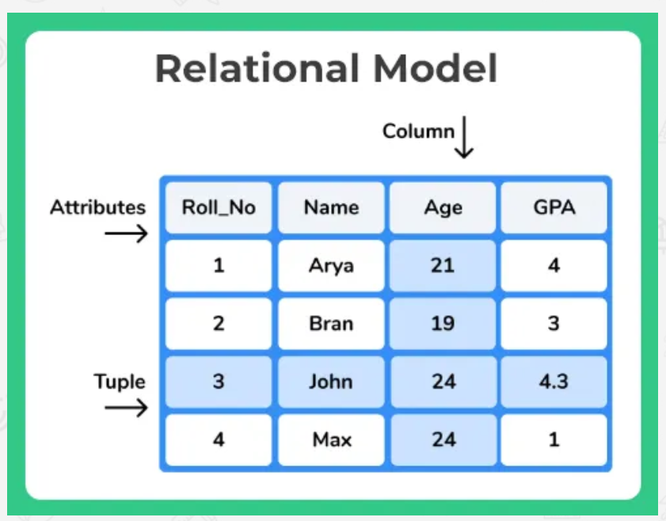
Relational model
This is the most used model and even with DBMS that we will studying in future posts it will be based upon the same. Relational model is a tabular 2 dimensional relationship between various related tables having at least one common field.
This works around
  Rows
  Entities
  Tuples
  Columns
  Table

Slide 20
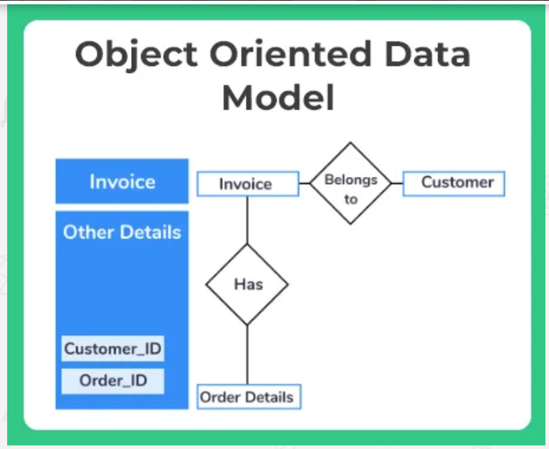
Object-oriented database model
The increasing complexity of the code in the modern age, where we try to create real time scenerios. Specially in Artificial Intelligence, Machine learning or Image processing.
We need a database that can also represent the real work scenerios very clearly and hence it is solved by having an object oriented database model.
  An object is an abstraction of a real-world entity. More or less an object is a real world instance of an entity in Entity Relationship Model
  Attributes describe the properties of an object, i.e customerID or orderID maybe called as properties of the object or attributes as in entity relationship model
  As we use classes and inheritance in OOPs concept. The similar can be used here. Classes are a superior set of objects with similar characteristics right?
  Inheritance is highly used in such, thus also using network or hierarchical model as default inspirations

Slide 21
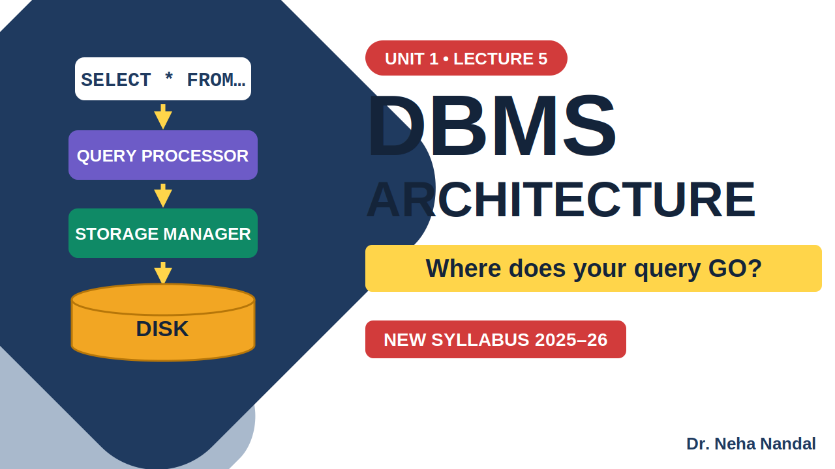

Slide 23
SELECT * FROM student WHERE hallticket = 'YOUR NUMBER';

Slide 24
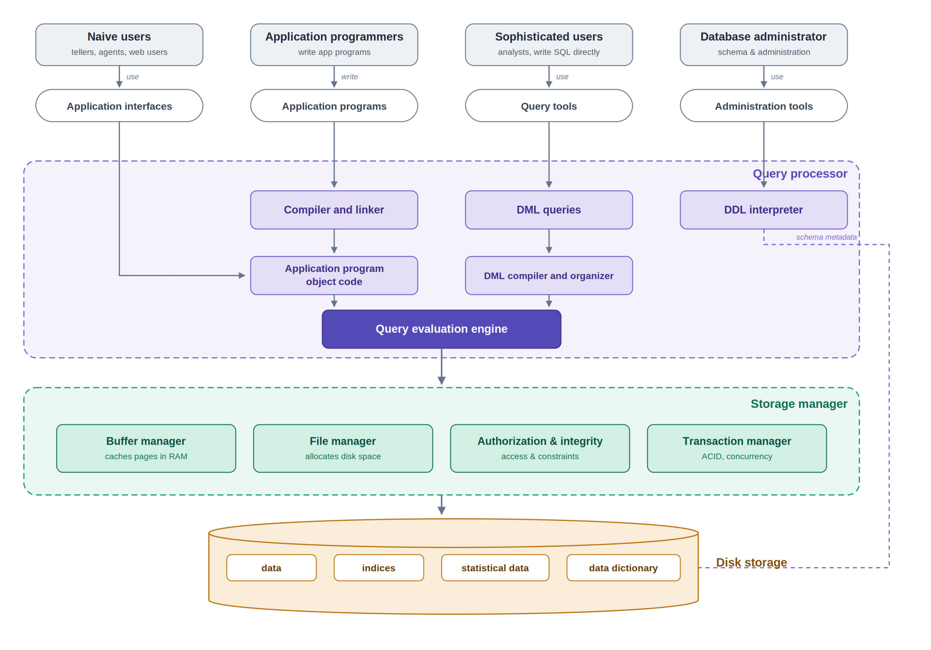

Slide 25

★ 2–3 marks: Types of database users

Slide 30
The functional components of a database system can be broadly divided into the storage manager and the query processor components.
Query Processor:
The query processor components include
· DDL interpreter, which interprets DDL statements and records the definitions in the data dictionary.
· DML compiler, which translates DML statements in a query language into an evaluation plan consisting
of low-level instructions that the query evaluation engine understands.
Storage Manager:
A storage manager is a program module that provides the interface between the lowlevel data stored in the
database and the application programs and queries submitted to the system. The storage manager is
responsible for the interaction with the file manager.
Transaction Manager:
A transaction is a collection of operations that performs a single logical function in a database application.
Each transaction is a unit of both atomicity and consistency. Thus, we require that transactions do not violate
any database-consistency constraints.

Slide 31
Authorization and integrity manager, which tests for the satisfaction of integrity constraints and checks
the authority of users to access data.
· Transaction manager, which ensures that the database remains in a consistent (correct) state despite
system failures, and that concurrent transaction executions proceed without conflicting.
· File manager, which manages the allocation of space on disk storage and the data structures used to
represent information stored on disk.
· Buffer manager, which is responsible for fetching data from disk storage into main memory, and deciding
what data to cache in main memory. The buffer manager is a critical part of the database system, since it
enables the database to handle data sizes that are much larger than the size of main memory.

Slide 32
Conceptual Database Design - Entity Relationship(ER) Modeling
A graphical technique for understanding and organizing the data independent of the actual database
implementation
Entity
Any thing that has an independent existence and about which we collect data. It is also known as entity type.
In ER modeling, notation for entity is given below.
In ER modeling, notation for weak entity is
Attributes
Properties/characteristics which describe entities are called attributes.

Slide 33
Domain of Attributes
The set of possible values that an attribute can take is called the domain of the attribute. For example, the
attribute day may take any value from the set {Monday, Tuesday ... Friday}. Hence this set can be termed as the
domain of the attribute day.
Key attribute
The attribute (or combination of attributes) which is unique for every entity instance is called key attribute.
Simple attribute
If an attribute cannot be divided into simpler components, it is a simple attribute
Composite attribute
If an attribute can be split into components, it is called a composite attribute.

Slide 34
Single valued Attributes
If an attribute can take only a single value for each entity instance, it is a single valued attribute
Multi-valued Attributes
If an attribute can take more than one value for each entity instance, it is a multi-valued attribute.
Stored Attribute
An attribute which need to be stored permanently is a stored attribute
Example for stored attribute : name of a student
Derived Attribute
An attribute which can be calculated or derived based on other attributes is a derived attribute.
Example for derived attribute : age of employee which can be calculated from date of birth and current date.

Slide 35
Relationships
Associations between entities are called relationships
Example : An employee works for an organization. Here "works for" is a relation between the entities employee
and organization.
weak relationship notation

Slide 36
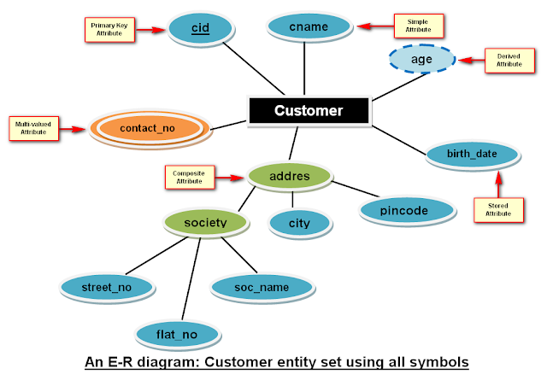

Slide 37
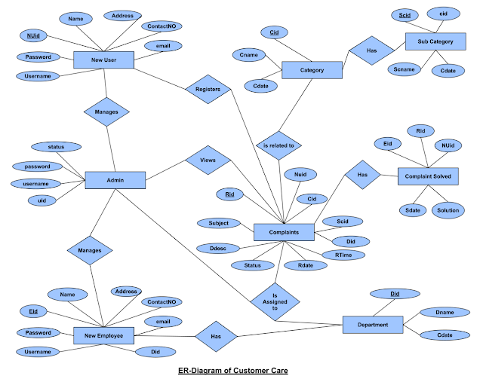

Slide 38
Cardinality of a Relationship
Relationship cardinalities specify how many of each entity type is allowed. Relationships can have four possible connectivities as given below.
1. One to one (1:1) relationship
2. One to many (1:N) relationship
3. Many to one (M:1) relationship
4. Many to many (M:N) relationship
One-to-One (1:1)

Slide 39
One-to-Many (1:N)
One organization can have many employees , but one employee works in only one organization. Hence it is a
1:N relationship and cardinality is One-To-Many (1:N)

Slide 40
Many-to-One (M :1)
One employee works in only one organization But one organization can have many employees. Hence it is a
M:1 relationship and cardinality is Many-to-One (M :1)

Slide 41
Many-to-Many (M:N)
One student can enroll for many courses and one course can be enrolled by many students. Hence it is a M:N
relationship and cardinality is Many-to-Many (M:N)

Slide 42
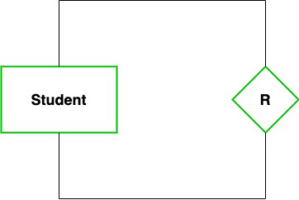
Degree of Relationship
.
In DBMS, a degree of relationship represents the number of entity types that associate in a relationship
Unary
In this type of relationship, both the associating entity type are the same. So, we can say that unary relationships exist when both entity types are the same and we call them the degree of relationship is 1.
Example: In a particular class, we have many students, there are monitors too. So, here class monitors are also students. Thus, we can say that only students are participating here. So the degree of such type of relationship is 1.

Slide 43

Binary (degree 2)
In a Binary relationship, there are two types of entity associates. So, we can say that a Binary relationship exists when there are two types of entity and we call them a degree of relationship is 2.
Example: We have two entity types ‘Student’ and ‘ID’ where each ‘Student’ has his ‘ID’. So, here two entity types are associating we can say it is a binary relationship.

Slide 44
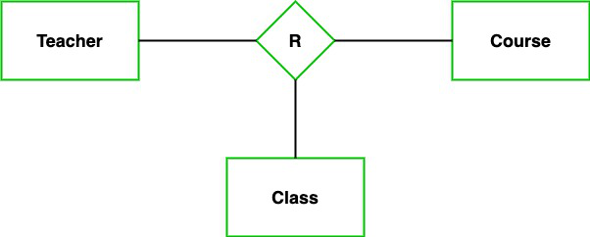
Ternary(degree 3)
In the Ternary relationship, there are three types of entity associates. So, we can say that a Ternary relationship exists when there are three types of entity and we call them a degree of relationship is 3.
Example: We have three entity types ‘Teacher’, ‘Course’, and ‘Class’. The relationship between these entities is defined as the teacher teaching a particular course, also the teacher teaches a particular class. So, here three entity types are associating we can say it is a ternary relationship.

Slide 45
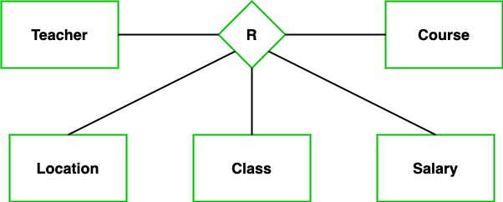
N-ary (n degree)
In the N-ary relationship, there are n types of entity that associates. So, we can say that an N-ary relationship exists when there are n types of entities.
Example: We have 5 entities Teacher, Class, Location, Salary, Course. So, here five entity types are associating we can say an n-ary relationship is 5.

Slide 46
Draw an er-model for project management system.

Slide 47
We will follow the 3 basic rules in creating the ER Diagram.
Identify all the entities.
Identify the relationship between entities and
Add meaningful attributes to our entities.

Slide 48
Entities:
Company
Project
Project Category
Project Member Assignment
Project Member
Project Manager
Project Updates

Slide 49
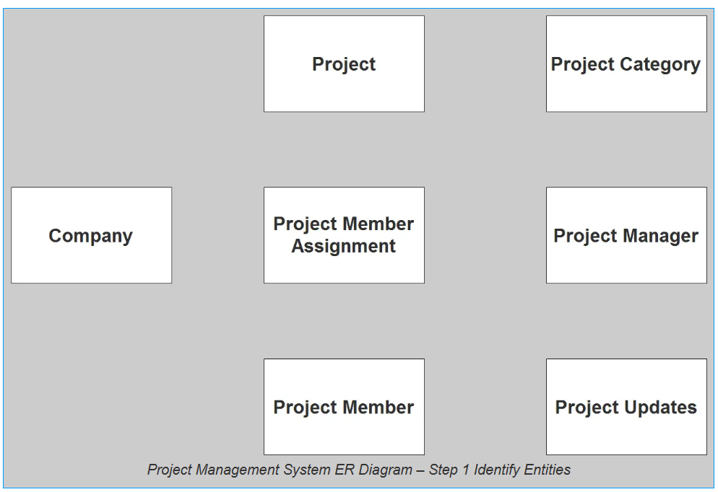

Slide 50
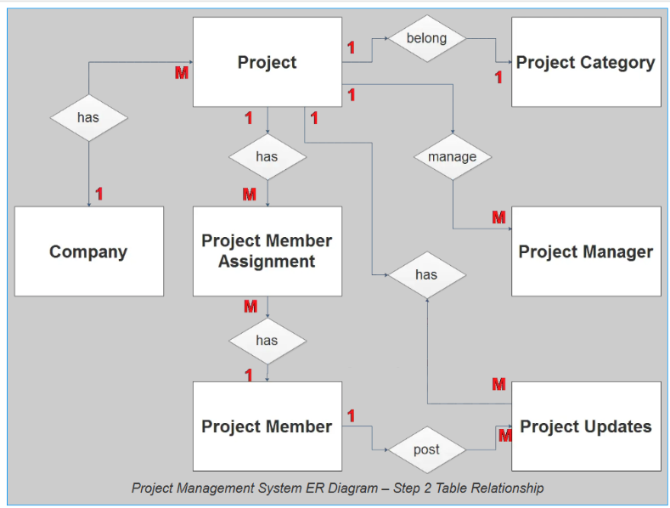
establish a relationship among the entities.

Slide 51
company has 1 or more projects to be managed (1 to many relationship).
the project belongs to a specific type or category (1 to 1 relationship).
the project can be managed by multiple project managers, it depends of the scope of the project, but to be more flexible the relationship will be set to (1 to many relationship).
The project will be assigned to several members (1 to many relationship).
The project member can be assigned to several tasks (1 to many relationship).
The project member posts an updates (1 to many relationship).
The project will receive an updates (1 to many relationship).

Slide 52
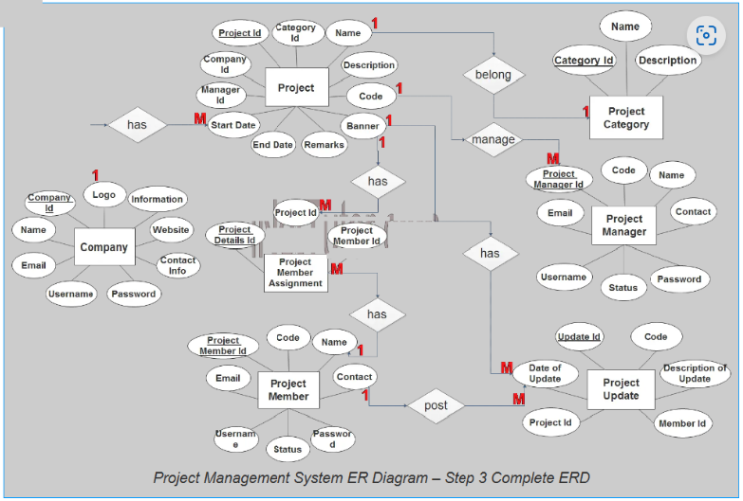
Add attributes

Slide 53
Additional features of er model
Enhanced entity-relationship diagrams are advanced database diagrams very similar to regular ER diagrams which represent the requirements and complexities of complex databases.
It is a diagrammatic technique for displaying the Sub Class and Super Class; Specialization and Generalization; Union or Category; Aggregation etc.

Slide 54
Generalization and Specialization: These are very common relationships found in real entities.
Specialized classes are often called subclass while a generalized class is called a superclass, probably inspired by object-oriented programming.
A sub-class is best understood by “IS-A analysis”. The following statements hopefully make some sense to your mind “Technician IS-A Employee”, and “Laptop IS-A Computer”.

Slide 55
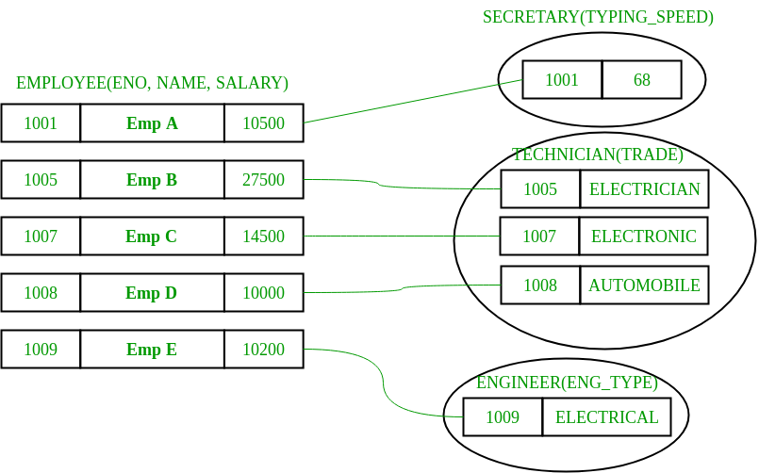
Sub-class entity “inherits” all attributes of super-class; for example, employee 1001 will have attributes eno, name, salary, and typing speed.

Slide 56
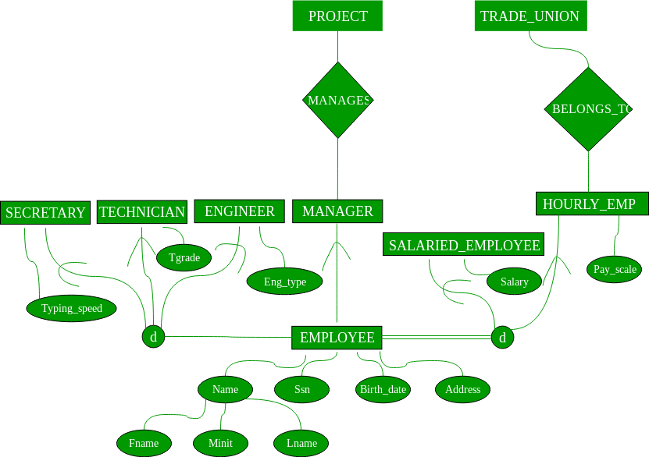

Slide 57
Constraints – There are two types of constraints on the “Sub-class” relationship.
Total or Partial – A sub-classing relationship is total if every super-class entity is to be associated with some sub-class entity, otherwise partial. Sub-class “job type based employee category” is partial sub-cl assing – not necessary every employee is one of (secretary, engineer, and technician)B N, i.e. union of these three types is a proper subset of all employees. Whereas other sub-classing “Salaried Employee AND Hourly Employee” is total; the union of entities from sub-classes is equal to the total employee set, i.e. every employee necessarily has to be one of them.
2. Overlapped or Disjoint – If an entity from a super-set can be related (can occur) in multiple sub-class sets, then it is overlapped sub-classing, otherwise disjoint. Both the examples: job-type based and salaries/hourly employee sub-classing are disjoint.

Slide 58
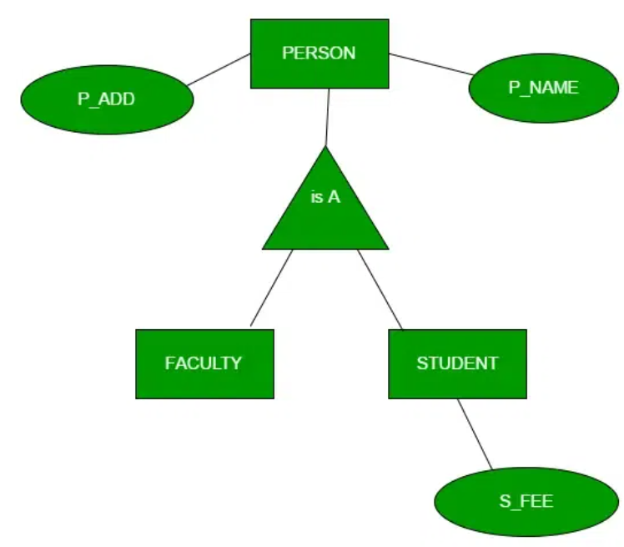
Generalization is the process of extracting common properties from a set of entities and creating a generalized entity from it. It is a bottom-up approach in which two or more entities can be generalized to a higher-level entity if they have some attributes in common. For Example, STUDENT and FACULTY can be generalized to a higher-level entity called PERSON as shown in Figure 1. In this case, common attributes like P_NAME, and P_ADD become part of a higher entity (PERSON), and specialized attributes like S_FEE become part of a specialized entity (STUDENT).
Generalization is also called as ‘ Bottom-up approach”.

Slide 59
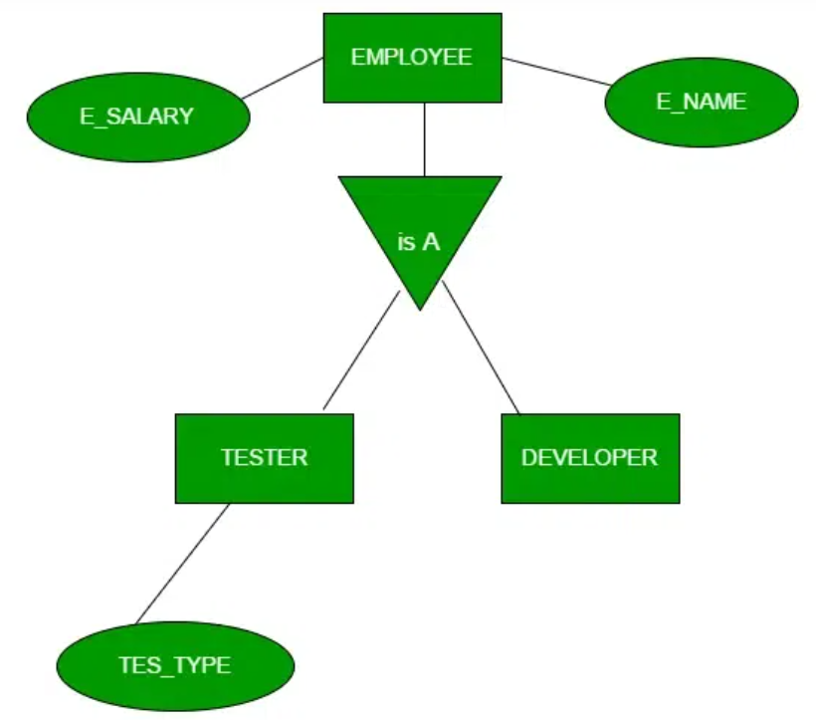
In specialization, an entity is divided into sub-entities based on its characteristics. It is a top-down approach where the higher-level entity is specialized into two or more lower-level entities. For Example, an EMPLOYEE entity in an Employee management system can be specialized into DEVELOPER, TESTER, etc. as shown in Figure 2. In this case, common attributes like E_NAME, E_SAL, etc. become part of a higher entity (EMPLOYEE), and specialized attributes like TES_TYPE become part of a specialized entity (TESTER).

Slide 60
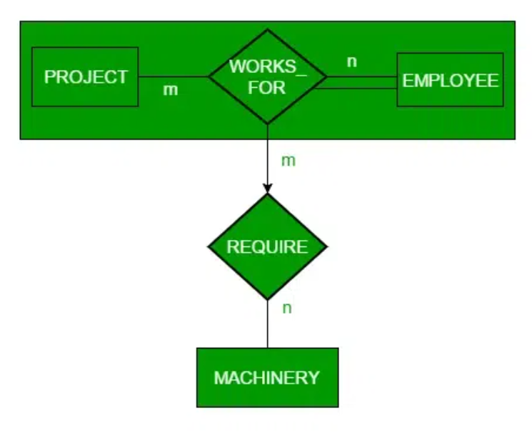
An ER diagram is not capable of representing the relationship between an entity and a relationship which may be required in some scenarios. In those cases, a relationship with its corresponding entities is aggregated into a higher-level entity. Aggregation is an abstraction through which we can represent relationships as higher-level entity sets.
For Example, an Employee working on a project may require some machinery. So, REQUIRE relationship is needed between the relationship WORKS_FOR and entity MACHINERY. Using aggregation, WORKS_FOR relationship with its entities EMPLOYEE and PROJECT is aggregated into a single entity and relationship REQUIRE is created between the aggregated entity and MACHINERY.

Slide 61
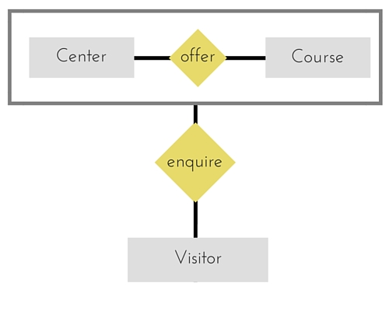
Another form of aggregation says that it is abstracting a relationship between objects and viewing the relationship as an object. So, in Figure 2, the Enrollment relationship between entities Center and Course entity can be viewed as entity REGISTRATION.
In simple terms, Aggregation is a process when relation between two entity is treated as a single entity.

Slide 62
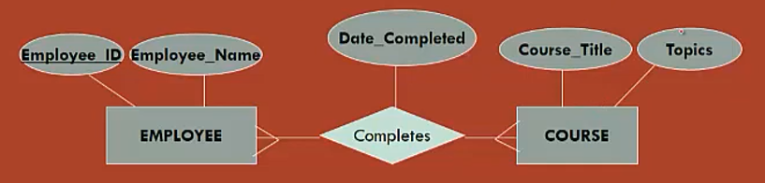
Associative entity (Bridge or intersection)
Associative entity is a type of entity that associate the instances of one or many entity type with one another.
The presence of one or mor attributes on a relationship suggest to the designer that the relationship should be represented as entity type.
This type of entity is known as Associative Entity

Slide 63
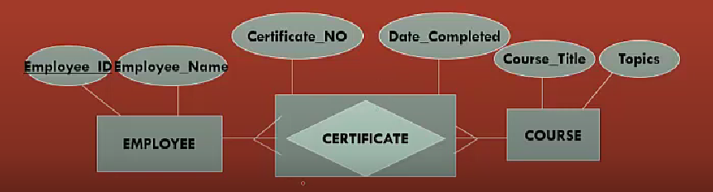
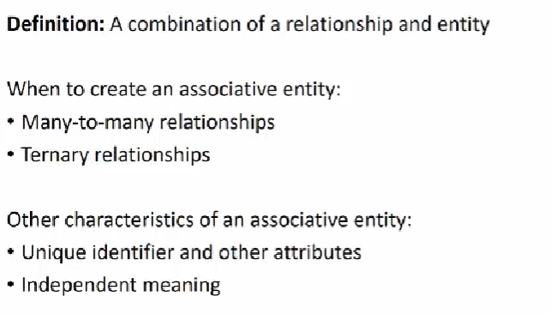

Slide 64
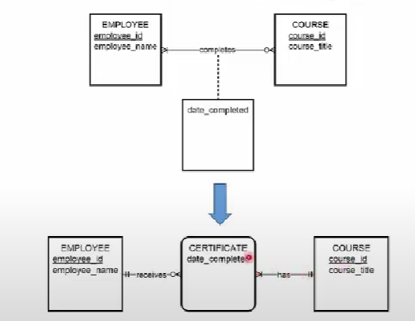

Slide 65
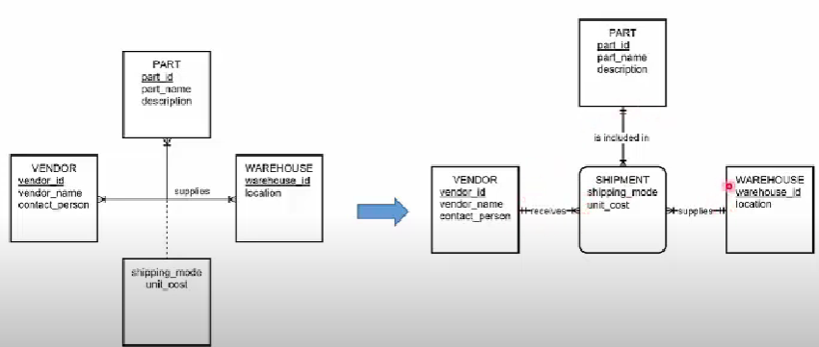

Slide 66
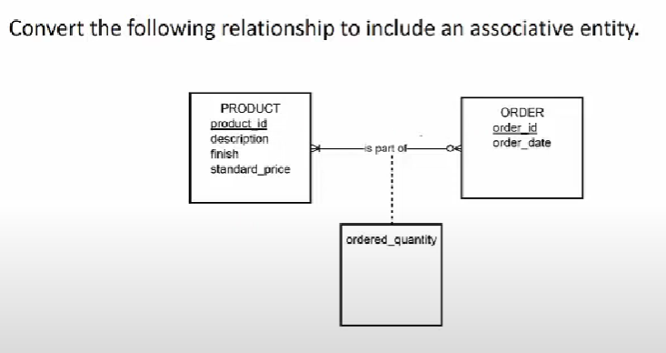

Slide 67
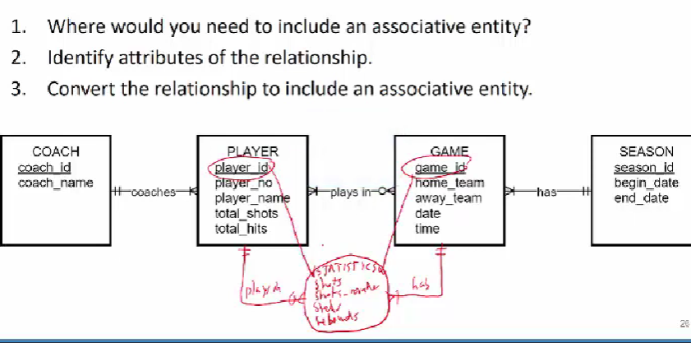

Slide 68
Advantages and Disadvantages of ER Modeling ( Merits and Demerits of ER Modeling )
Advantages
1. ER Modeling is simple and easily understandable. It is represented in business users language and it can be
understood by non-technical specialist.
2. Intuitive and helps in Physical Database creation.
3. Can be generalized and specialized based on needs.
4. Can help in database design.
5. Gives a higher level description of the system.
Disadvantages
1. Physical design derived from E-R Model may have some amount of ambiguities or inconsistency.
2. Sometime diagrams may lead to misinterpretations

Slide 69
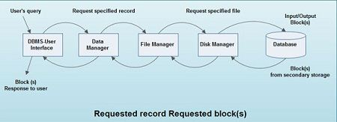
Database Access for Application Programs:
Any access to the stored data is done by the data manager. A user’s request for data is-received by the data manager, which determines the physical record required.
The data manager sends the request for a specific physical record to the file manager. The file manager decides which physical block of secondary storage devices contains the required record and sends the request for the appropriate block to the disk manager.

Slide 70
The database management system is a bridge between the application program, (that determines what data are needed and how they are processed), and the operating system of the computer, which is responsible for placing data on the magnetic storage devices.
To retrieve data from the database, the following operations are performed internally:
• A user issues an access request, using some application program or data manipulation language.
• The application program determines what data are needed and communicates the need to the database management system.
• The DBMS intercepts the request and interprets it .
• . The DBMS inspects, in turn, the external schema, the external/conceptual mapping, the conceptual schema, the conceptually internal mapping, and storage structure definition.
• The data base management system instructs the operating system to locate and retrieve the data from the specific location on the magnetic disk (or whatever device it is stored on).
• A copy of the data is given to the application program for processing.

Slide 71
Data Storage and Querying,– data base Users and Administrator
Data Storage
Data Storage Manager also known as “Database Control System”, is generally a program that provides an interface between the data/information stored and the queries received. It helps us to maintain the integrity and consistency of the database by applying the constraints.
Storage Manager is generally in charge of the interactions with the File Manager, where raw data is stored on the data with the help of the file system. It translates various DML statements into low-level commands.

Slide 72
Authorization and Integrity Manager: The main purpose of the Authorization and Integrity Manager is to ensure the satisfaction of the integrity constraints and checks the authority of users to access information.
Transaction Manager: The main purpose of Transaction Manager is to ensure that even after the system failures, the database should remain in a uniform state.
File Manager: The main purpose of File Manager is to manage the allocation of space on the disk storage.
Buffer Manager: The main purpose of Buffer Manager is to fetch the data from disk storage into the main memory.

Slide 73
Query Processor:
Query Processor contains the following three components:
DDL Interpreter: DDL Interpreter is the Data Definition Language Interpreter which is basically used to build and modify the structure of your tables and other objects in the table.
DML Compiler: DML Compiler is the Data Manipulation Language which is used for adding (inserting), deleting, and modifying (updating) data in a database. or we can say translating the DML statements into query language consists of low-level instructions that only query engine can understand.
Query Evaluation Engine: It basically executes the low-level language instructions, generated by DML Compiler.

Slide 74
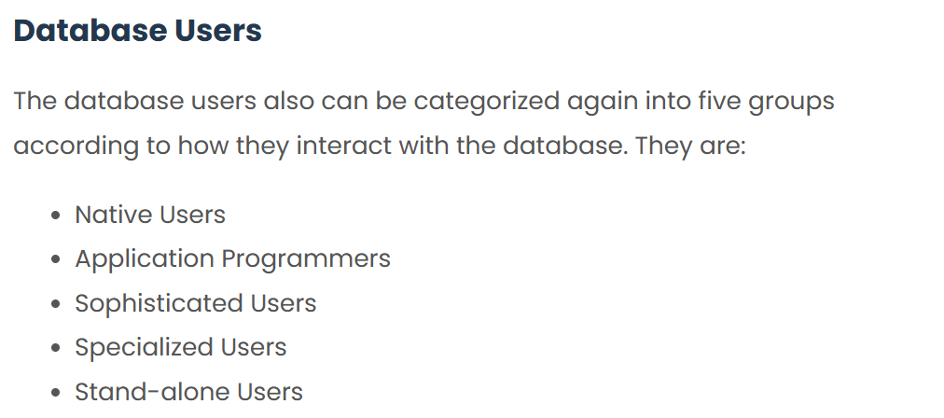

Slide 75
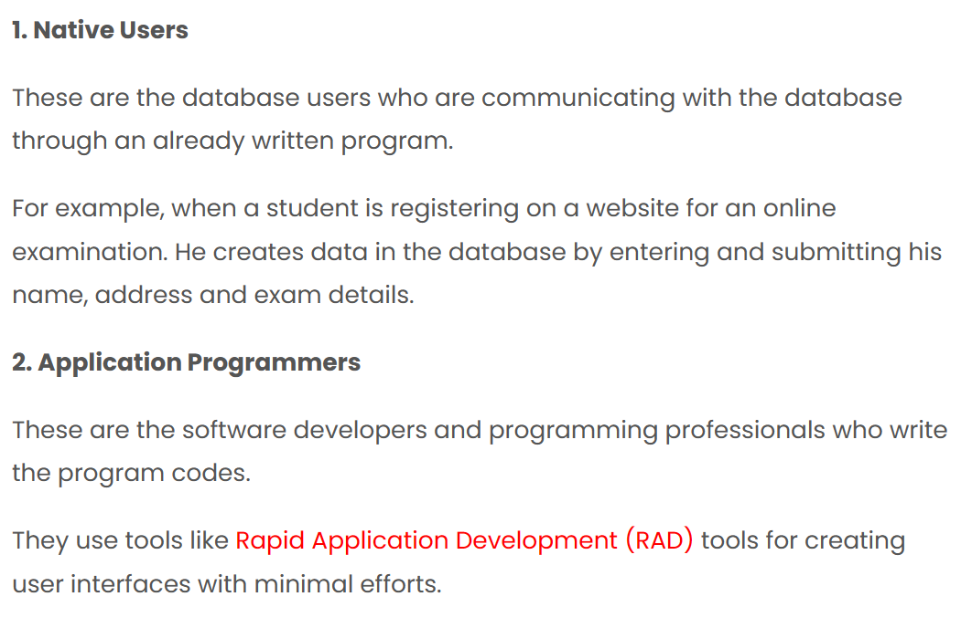

Slide 76
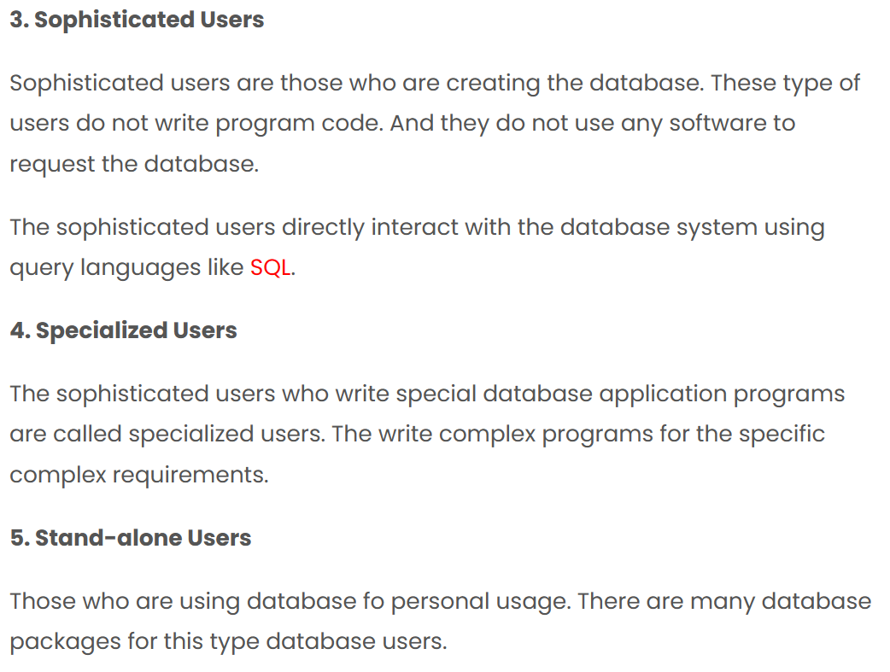

Slide 77

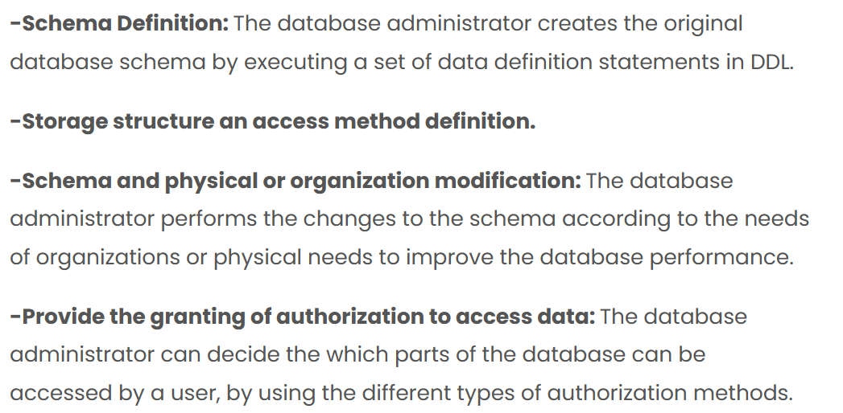

Slide 78
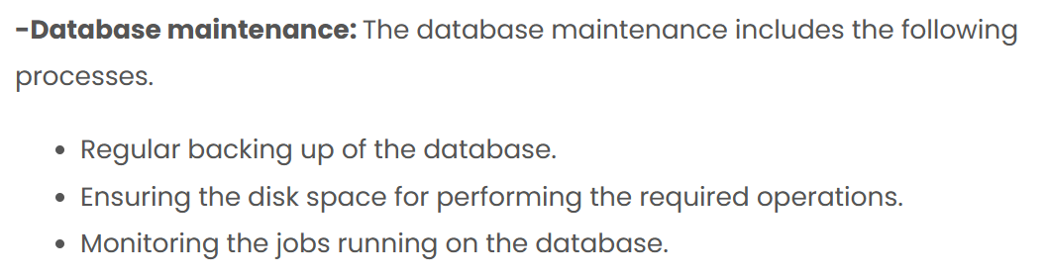

Slide 79
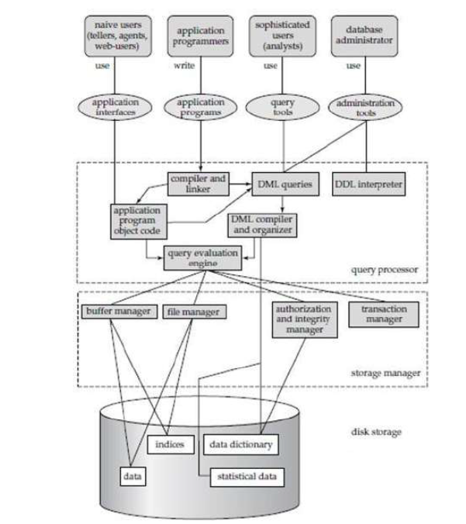
Database system structure

Slide 80
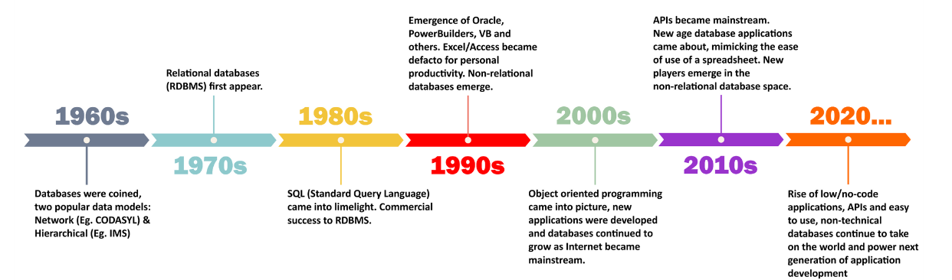
History of database systems
What is a database: A beginner's guide | Stackby [Updated 2023]

Slide 81
DATABSE LANGUAGES:
SQL | DDL, DQL, DML, DCL and TCL Commands
Structured Query Language(SQL) as we all know is the database language by the use of which we can perform certain operations on the existing database and also we can use this language to create a database.
Structured Query Language(SQL) as we all know is the database language by the use of which we can perform certain operations on the existing database and also we can use this language to create a database.

Slide 82
SQL commands are mainly categorized into five categories:
DDL – Data Definition Language
DQL – Data Query Language
DML – Data Manipulation Language
DCL – Data Control Language
TCL – Transaction Control Language

Slide 83
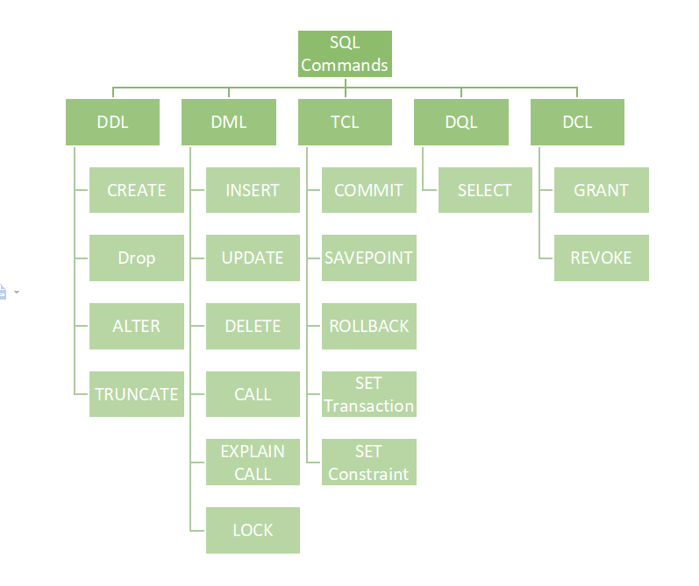

Slide 84
DDL (Data Definition Language)
It actually consists of the SQL commands that can be used to define the database schema. It simply deals with descriptions of the database schema and is used to create and modify the structure of database objects in the database.
List of DDL commands:
CREATE: This command is used to create the database or its objects (like table, index, function, views, store procedure, and triggers).
DROP: This command is used to delete objects from the database.
ALTER: This is used to alter the structure of the database.
TRUNCATE: This is used to remove all records from a table, including all spaces allocated for the records are removed.
COMMENT: This is used to add comments to the data dictionary.
RENAME: This is used to rename an object existing in the database.

Slide 85
DQL (Data Query Language)
DQL statements are used for performing queries on the data within schema objects. The purpose of the DQL Command is to get some schema relation based on the query passed to it.
List of DQL:
SELECT: It is used to retrieve data from the database.

Slide 86
DML(Data Manipulation Language)
The SQL commands that deal with the manipulation of data present in the database belong to DML or Data Manipulation Language and this includes most of the SQL statements. It is the component of the SQL statement that controls access to data and to the database. Basically, DCL statements are grouped with DML statements.
List of DML commands:
INSERT: It is used to insert data into a table.
UPDATE: It is used to update existing data within a table.
DELETE: It is used to delete records from a database table.
LOCK: Table control concurrency.
CALL: Call a PL/SQL or JAVA subprogram.
EXPLAIN PLAN: It describes the access path to data.

Slide 87
DCL (Data Control Language)
DCL includes commands such as GRANT and REVOKE which mainly deal with the rights, permissions, and other controls of the database system.
List of DCL commands:
GRANT: This command gives users access privileges to the database.
Syntax:
GRANT SELECT, UPDATE ON MY_TABLE TO SOME_USER, ANOTHER_USER;
REVOKE: This command withdraws the user’s access privileges given by using the GRANT command.
Syntax:
REVOKE SELECT, UPDATE ON MY_TABLE FROM USER1, USER2;

Slide 88
TCL (Transaction Control Language)
Transactions group a set of tasks into a single execution unit. Each transaction begins with a specific task and ends when all the tasks in the group successfully complete.
BEGIN: Opens a Transaction.
COMMIT: Commits a Transaction.
Syntax:
COMMIT;
ROLLBACK: Rollbacks a transaction in case of any error occurs.
Syntax:
ROLLBACK;
SAVEPOINT: Sets a save point within a transaction.
Syntax:
SAVEPOINT SAVEPOINT_NAME;

Slide 89
MySQL Data Types
In MySQL there are three main data types:
String,
Numeric, And
Date And Time.

Slide 90
String
Data type | Description
CHAR(size) | A FIXED length string (can contain letters, numbers, and special characters). The size parameter specifies the column length in characters - can be from 0 to 255. Default is 1
VARCHAR(size) | A VARIABLE length string (can contain letters, numbers, and special characters). The size parameter specifies the maximum column length in characters - can be from 0 to 65535
BINARY(size) | Equal to CHAR(), but stores binary byte strings. The size parameter specifies the column length in bytes. Default is 1
VARBINARY(size) | Equal to VARCHAR(), but stores binary byte strings. The size parameter specifies the maximum column length in bytes.
TINYBLOB | For BLOBs (Binary Large OBjects). Max length: 255 bytes
TINYTEXT | Holds a string with a maximum length of 255 characters
TEXT(size) | Holds a string with a maximum length of 65,535 bytes
BLOB(size) | For BLOBs (Binary Large OBjects). Holds up to 65,535 bytes of data
MEDIUMTEXT | Holds a string with a maximum length of 16,777,215 characters
MEDIUMBLOB | For BLOBs (Binary Large OBjects). Holds up to 16,777,215 bytes of data
LONGTEXT | Holds a string with a maximum length of 4,294,967,295 characters
LONGBLOB | For BLOBs (Binary Large OBjects). Holds up to 4,294,967,295 bytes of data
ENUM(val1, val2, val3, ...) | A string object that can have only one value, chosen from a list of possible values. You can list up to 65535 values in an ENUM list. If a value is inserted that is not in the list, a blank value will be inserted. The values are sorted in the order you enter them
SET(val1, val2, val3, ...) | A string object that can have 0 or more values, chosen from a list of possible values. You can list up to 64 values in a SET list

Slide 91
Numeric
Data type | Description
BIT(size) | A bit-value type. The number of bits per value is specified in size. The size parameter can hold a value from 1 to 64. The default value for size is 1.
TINYINT(size) | A very small integer. Signed range is from -128 to 127. Unsigned range is from 0 to 255. The size parameter specifies the maximum display width (which is 255)
BOOL | Zero is considered as false, nonzero values are considered as true.
BOOLEAN | Equal to BOOL
SMALLINT(size) | A small integer. Signed range is from -32768 to 32767. Unsigned range is from 0 to 65535. The size parameter specifies the maximum display width (which is 255)
MEDIUMINT(size) | A medium integer. Signed range is from -8388608 to 8388607. Unsigned range is from 0 to 16777215. The size parameter specifies the maximum display width (which is 255)
INT(size) | A medium integer. Signed range is from -2147483648 to 2147483647. Unsigned range is from 0 to 4294967295. The size parameter specifies the maximum display width (which is 255)
INTEGER(size) | Equal to INT(size)
BIGINT(size) | A large integer. Signed range is from -9223372036854775808 to 9223372036854775807. Unsigned range is from 0 to 18446744073709551615. The size parameter specifies the maximum display width (which is 255)
FLOAT(size, d) | A floating point number. The total number of digits is specified in size. The number of digits after the decimal point is specified in the d parameter. This syntax is deprecated in MySQL 8.0.17, and it will be removed in future MySQL versions
FLOAT(p) | A floating point number. MySQL uses the p value to determine whether to use FLOAT or DOUBLE for the resulting data type. If p is from 0 to 24, the data type becomes FLOAT(). If p is from 25 to 53, the data type becomes DOUBLE()
DOUBLE(size, d) | A normal-size floating point number. The total number of digits is specified in size. The number of digits after the decimal point is specified in the d parameter
DOUBLE PRECISION(size, d)
DECIMAL(size, d) | An exact fixed-point number. The total number of digits is specified in size. The number of digits after the decimal point is specified in the d parameter. The maximum number for size is 65. The maximum number for d is 30. The default value for size is 10. The default value for d is 0.
DEC(size, d) | Equal to DECIMAL(size,d)

Slide 92
Date And Time
Data type | Description
DATE | A date. Format: YYYY-MM-DD. The supported range is from '1000-01-01' to '9999-12-31'
DATETIME(fsp) | A date and time combination. Format: YYYY-MM-DD hh:mm:ss. The supported range is from '1000-01-01 00:00:00' to '9999-12-31 23:59:59'. Adding DEFAULT and ON UPDATE in the column definition to get automatic initialization and updating to the current date and time
TIMESTAMP(fsp) | A timestamp. TIMESTAMP values are stored as the number of seconds since the Unix epoch ('1970-01-01 00:00:00' UTC). Format: YYYY-MM-DD hh:mm:ss. The supported range is from '1970-01-01 00:00:01' UTC to '2038-01-09 03:14:07' UTC. Automatic initialization and updating to the current date and time can be specified using DEFAULT CURRENT_TIMESTAMP and ON UPDATE CURRENT_TIMESTAMP in the column definition
TIME(fsp) | A time. Format: hh:mm:ss. The supported range is from '-838:59:59' to '838:59:59'
YEAR | A year in four-digit format. Values allowed in four-digit format: 1901 to 2155, and 0000. MySQL 8.0 does not support year in two-digit format.

Slide 93
Relational Model
A relational database consists of a collection of tables, each of which is assigned a unique name.
In the relational model the term relation is used to refer to a table, while the term tuple is used to refer to
a row. Similarly, the term attribute refers to a column of a table.

Slide 94
Attribute: Attributes are the properties that define an entity. e.g.; ROLL_NO, NAME, ADDRESS
Relation Schema: A relation schema defines the structure of the relation and represents the name of the relation with its attributes. e.g.; STUDENT (ROLL_NO, NAME, ADDRESS, PHONE, and AGE) is the relation schema for STUDENT. If a schema has more than 1 relation, it is called Relational Schema.
Tuple: Each row in the relation is known as a tuple. The above relation contains 4 tuples, one of which is shown as:
Relation Instance: The set of tuples of a relation at a particular instance of time is called a relation instance. Table 1 shows the relation instance of STUDENT at a particular time. It can change whenever there is an insertion, deletion, or update in the database.
Degree: The number of attributes in the relation is known as the degree of the relation. The STUDENT relation defined above has degree 5.
Cardinality: The number of tuples in a relation is known as cardinality. The STUDENT relation defined above has cardinality 4.
Column: The column represents the set of values for a particular attribute. The column ROLL_NO is extracted from the relation STUDENT.

Slide 95
Relation Key: These are basically the keys that are used to identify the rows uniquely or also help in identifying tables. These are of the following types.

Slide 96
Integrity Constraints over relations
Integrity constraints are a set of rules. It is used to maintain the quality of information.
Integrity constraints ensure that the data insertion, updating, and other processes have to be performed in such a way that data integrity is not affected.
Thus, integrity constraint is used to guard against accidental damage to the database.

Slide 97
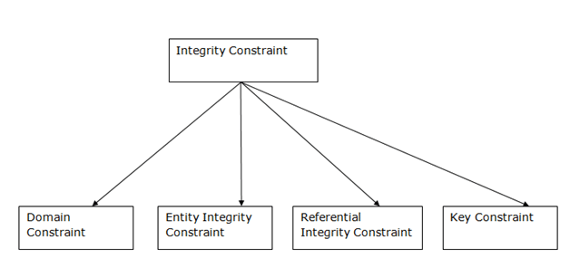

Slide 98
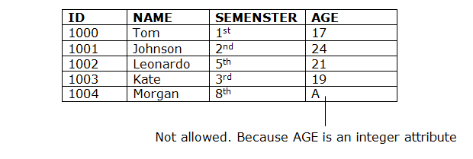
Domain constraints
Domain constraints can be defined as the definition of a valid set of values for an attribute.
The data type of domain includes string, character, integer, time, date, currency, etc. The value of the attribute must be available in the corresponding domain.

Slide 99
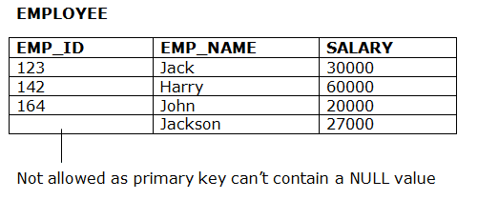
Entity integrity constraints
The entity integrity constraint states that primary key value can't be null.
This is because the primary key value is used to identify individual rows in relation and if the primary key has a null value, then we can't identify those rows.
A table can contain a null value other than the primary key field.

Slide 100
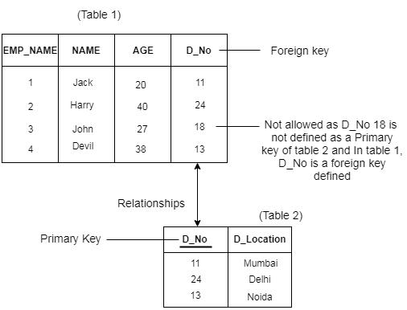
Referential Integrity Constraints
A referential integrity constraint is specified between two tables.
In the Referential integrity constraints, if a foreign key in Table 1 refers to the Primary Key of Table 2, then every value of the Foreign Key in Table 1 must be null or be available in Table 2.

Slide 101
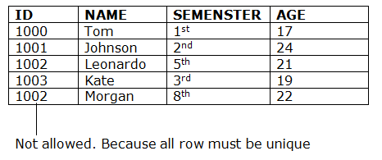
Key constraints
Keys are the entity set that is used to identify an entity within its entity set uniquely.
An entity set can have multiple keys, but out of which one key will be the primary key. A primary key can contain a unique and null value in the relational table.

Slide 102
Enforce Integrity Constraints
There are several ways to enforce integrity constraints in a DBMS:
Declarative referential integrity: This method involves specifying the integrity constraints at the time of database design and allowing the DBMS to enforce them automatically.
Triggers: A trigger is a special type of stored procedure that is executed automatically by the DBMS when certain events occur (such as inserting, updating, or deleting data). Triggers can be used to enforce integrity constraints by checking for and rejecting invalid data.
Stored procedures: A stored procedure is a pre-defined set of SQL statements that can be executed as a single unit. Stored procedures can be used to enforce integrity constraints by performing checks on the data before it is inserted, updated, or deleted.
Application-level code: Integrity constraints can also be enforced at the application level by writing code to check for and reject invalid data before it is entered into the database.
It is important to carefully consider the appropriate method for enforcing integrity constraints in a DBMS in order to ensure the accuracy and consistency of the data.

Slide 103
Logical Database
A Logical Database is a special type of ABAP (Advance Business Application and Programming) that is used to retrieve data from various tables and the data is interrelated to each other. Also, a logical database provides a read-only view of Data.
A Logical database uses only a hierarchical structure of tables i.e. Data is organized in a Tree-like Structure and the data is stored as records that are connected to each other through edges (Links). Logical Database contains Open SQL statements which are used to read data from the database. The logical database reads the program, stores them in the program if required, and passes them line by line to the application program.

Slide 104
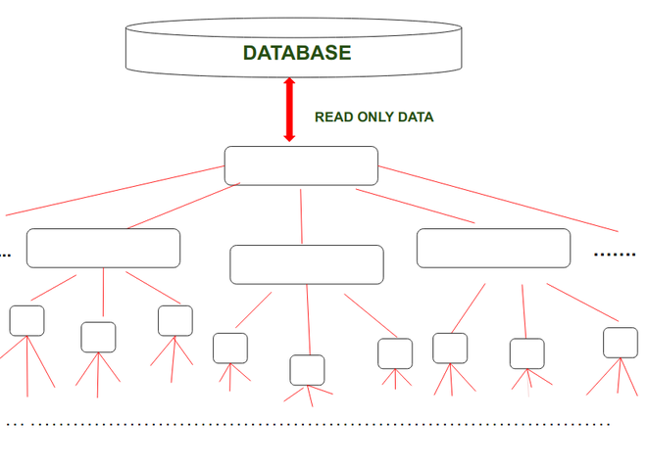

Slide 105
Features of Logical Database:
In this section, let us look at some features of a logical database:
We can select only that type of Data that we need.
Data Authentication is done in order to maintain security.
Logical Database uses hierarchical Structure due to this data integrity is maintained.

Slide 106
Data View Of Logical Database:
Logical Database provides a particular view of Logical Database tables. A logical database is appropriately used when the structure of the Database is Large. It is convenient to use flow i. e.
SELECT
READ
PROCESS
DISPLAY
In order to work with databases efficiently. The data of the Logical Database is hierarchical in nature. The tables are linked to each other in a Foreign Key relationship.

Slide 107
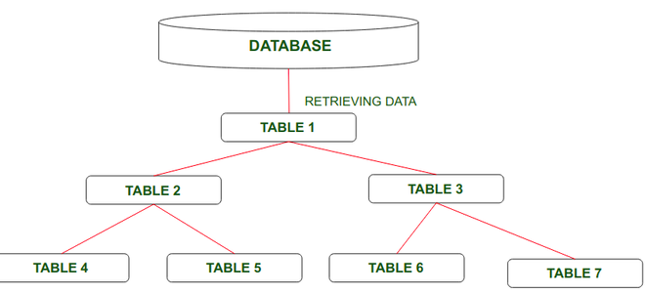

Slide 108
Advantages Of Logical Database:
Let us look at some advantages of the logical database:
In a Logical database, we can select meaningful data from a large amount of data.
Logical Database consists of Central Authorization which checks for Database Accesses is Authenticated or not.
In this Coding, the part is less required to retrieve data from the database as compared to Other Databases.
Access performance of reading data from the hierarchical structure of the Database is good.
Easy to understand user interfaces.
Logical Database firstly check functions which further check that user input is complete, correct, and plausible.

Slide 109
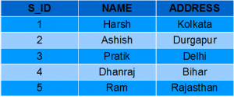

views
Views in SQL are kind of virtual tables. A view also has rows and columns as they are in a real table in the database. We can create a view by selecting fields from one or more tables present in the database. A View can either have all the rows of a table or specific rows based on certain condition.
Student Details
Student Marks

Slide 110
We can create View using CREATE VIEW statement. A View can be created from a single table or multiple tables. Syntax:
CREATE VIEW view_name AS
SELECT column1, column2.....
FROM table_name
WHERE condition;

Slide 111
we will create a View named DetailsView from the table StudentDetails. Query:
CREATE VIEW DetailsView AS
SELECT NAME, ADDRESS
FROM StudentDetails
WHERE S_ID < 5;
SELECT * FROM DetailsView;

Slide 112
We can delete or drop a View using the DROP statement. Syntax:
DROP VIEW view_name;

Slide 113
THANK YOU

